Slide 1
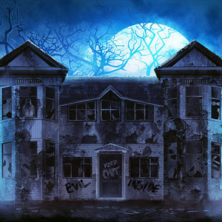
The mysterious haunted house
by: Zach and Eva

Slide 2
It is 11 o’clock, in the house, Jeff prepares his costume and Carlota puts on her costume for Halloween.
Jeff is a clown and Carlota isaa little Fairy. Jeff scares Carlota with his costume.
I am very excited to go get candy!
Me too!

Slide 3
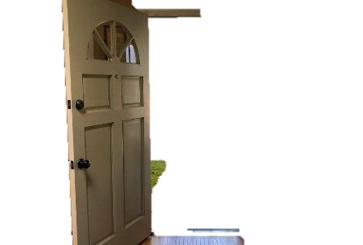
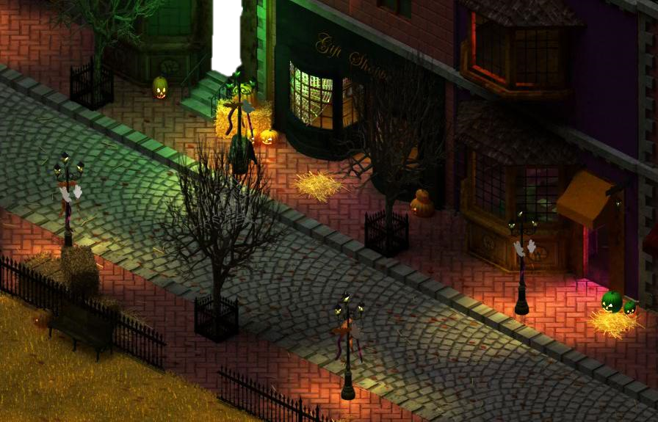
house! Let’s go explore this house!
It is midnight, the siblings are walking on the street to go Trick or Treating.
After filling up their bags with candy, they see a house with an open door.
I am not sure about this.
Jeff does not listen to
his sister.
Carlota doesn’t want to be alone, so she follows him in the haunted house.

Slide 4
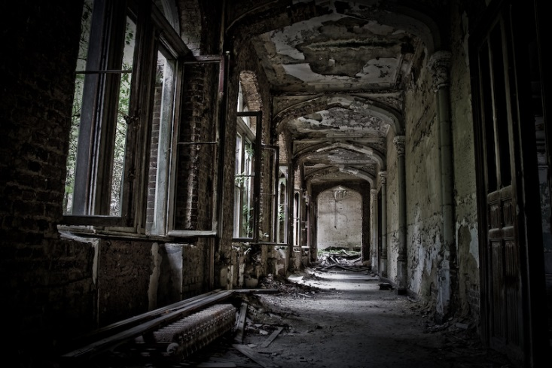
In the house, they hear some strange noises coming from the basement.
Carlota checks the kitchen and Jeff goes in
the other rooms.
You are scared for no reason Carlota, there is no danger in this house.
Jeff, I’m scared!

Slide 5
Jeff, the clown suddenly hears a loud voice.
Come little kids I will give you a lot of candy! Hi Hi Hi!
AHHHH!

Slide 6
Jeff is paralyzed. His sister runs to the door but the door is locked.
Ho no! Somebody locked the door!

Slide 7
I think we have to go in the basement maybe there is a place to escape.
OK…

Slide 8
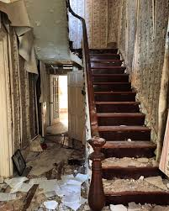
When Jeff steps on the first stair, the stair creaks.
The noise that the kids heard before starts again but very much louder than the other time.

Slide 9
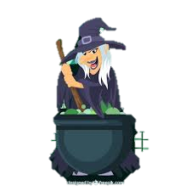
They go down carefully and they see a very ugly and old witch. Then, Jeff sees 4 bats flying in front of him. The witch stirs a strange green and sticky mixture in a pot. The mixture bubbles and bubbles.

Slide 10
Carlota notices a door at the back of the basement.
Look Jeff, there is a door over there.

Slide 11
Wow! What a terrifying adventure!
The siblings run to the door, the little fairy opens it and they escape.

Slide 12
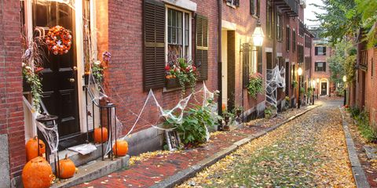
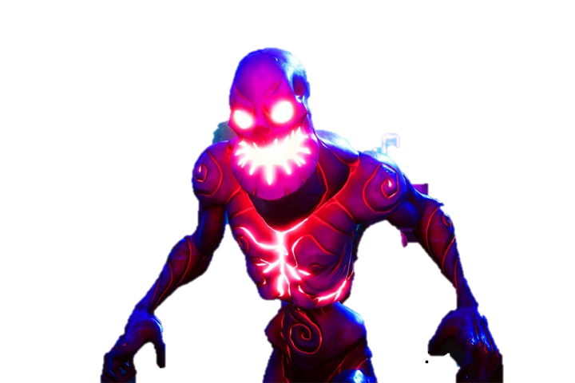
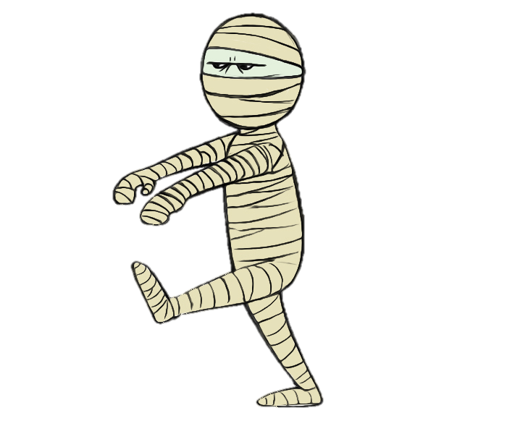
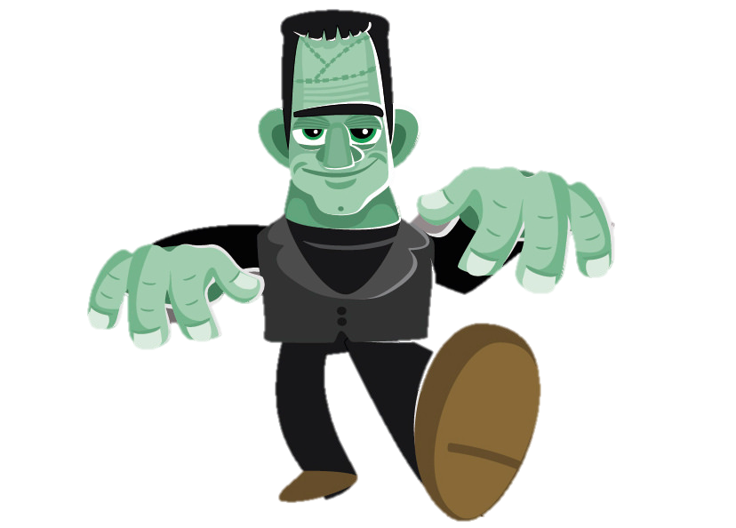
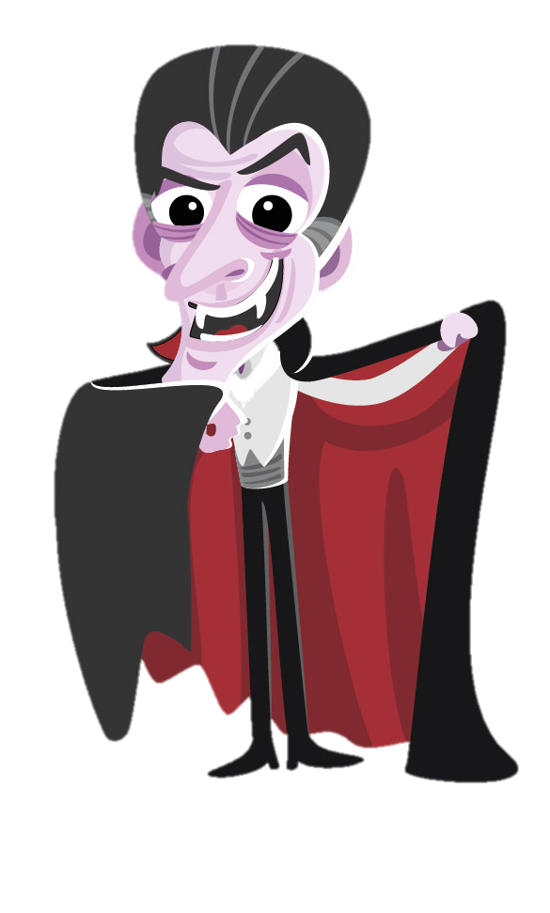
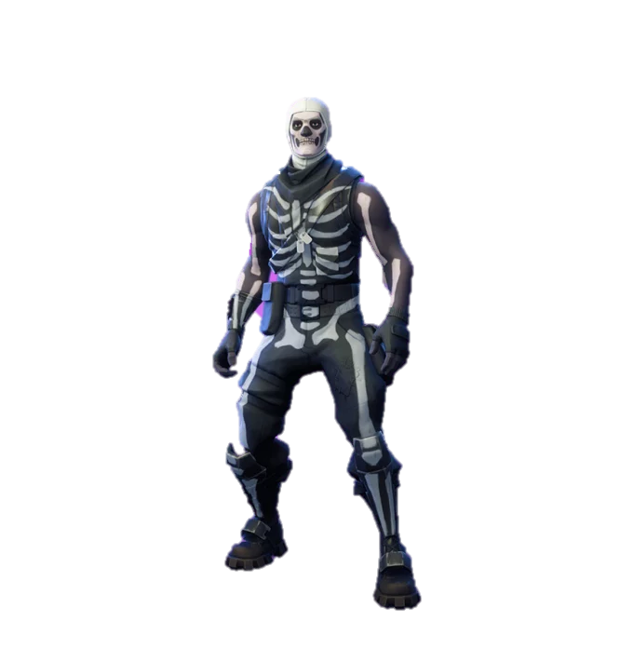
Oh look and over there, there is the scary ghost, the disgusting zombie, the creepy mummy and the wonderful jack o lantern!
Look Carlota, there is the vampire, Frankenstein, the evil devil and the white skeleton.

Slide 13
When they go back home, their parents ask them if their night was cool. The brother explains their terrifying adventure.
Let’s go home, I am very tired!

Slide 14
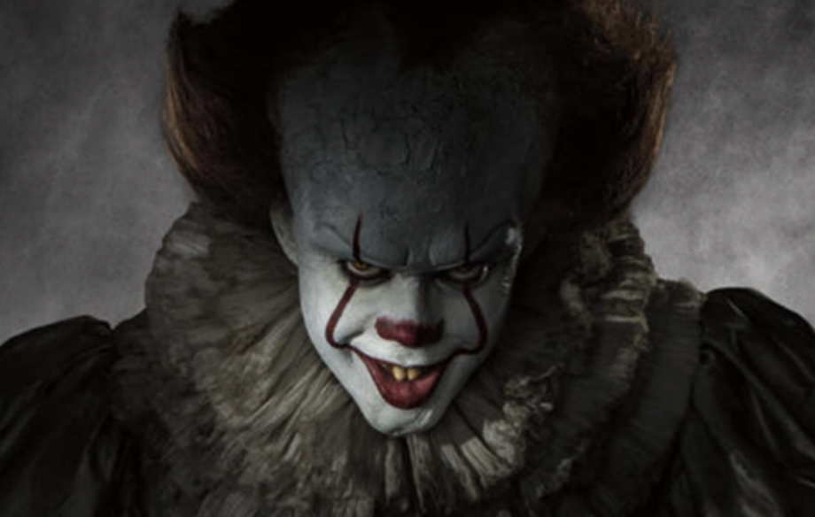
THAT’S THE END!

