Slide 1
Twin-lloween
By : Ines and Laura
Intensive English
October 31, 2015

Slide 2
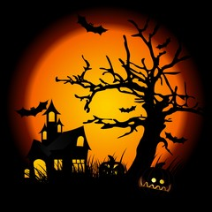
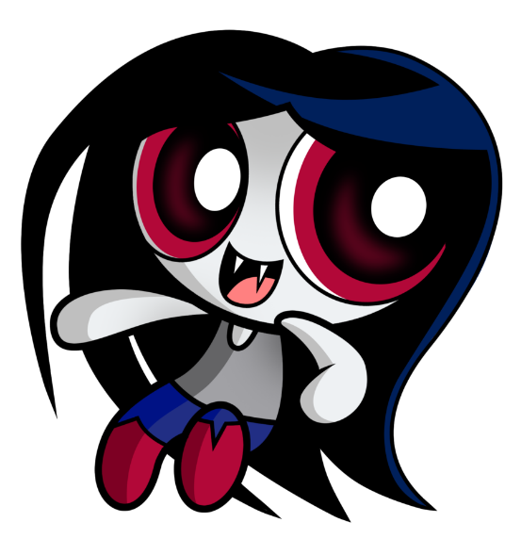
It is a strange and cold Halloween night! The twin sisters Emily and Lea have their own costumes. They are really proud of themselves. Lea wears a werewolf costume and Emily dresses as a vampire one. Lea wants to visit the scaryiest houses on the street. Emily prefers to go trick-or-treating.
Your costume looks very freaky.
Thank you, yours seems like a real werewolf.

Slide 3
Lea decides to visit a terrifying haunted-house with her twin sister. Emily loses her sister during the tour. A ghost scares Emily.
Lea, I’m to scare. Can you join me at the old cemetery ?

Slide 4
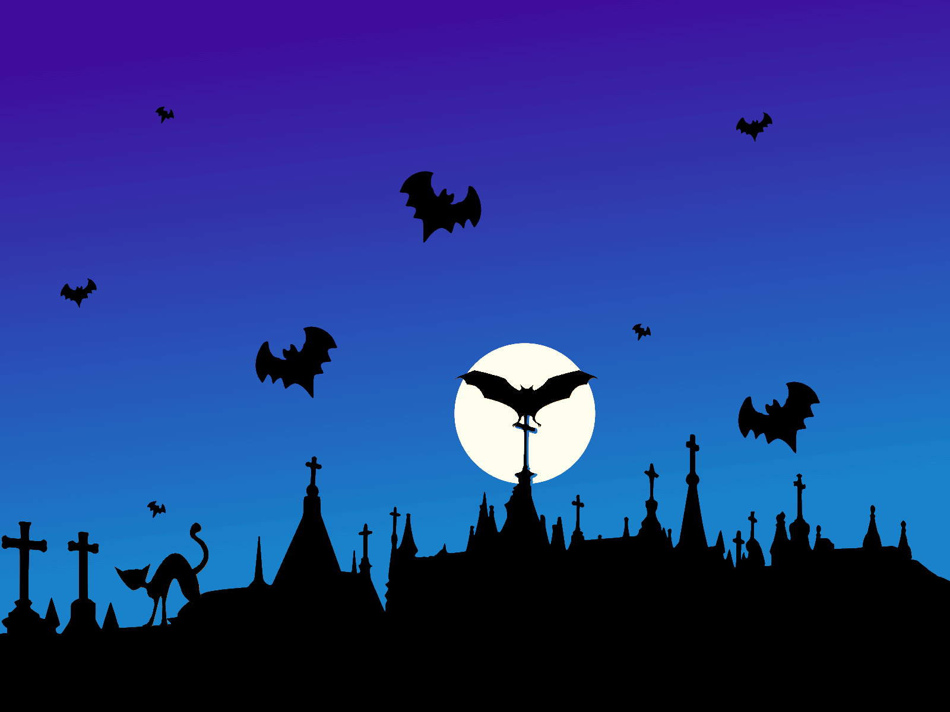
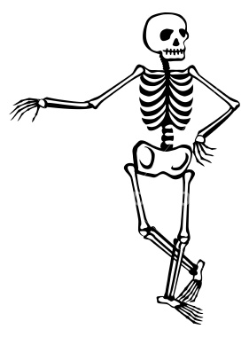
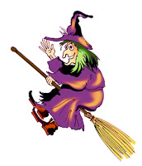
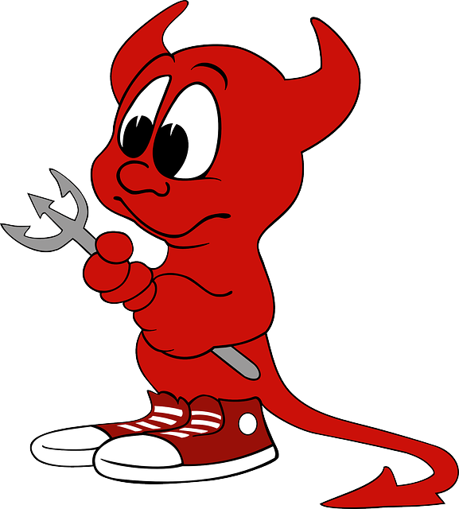
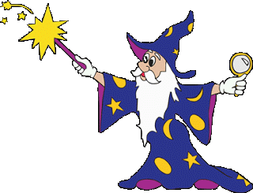
At the old cemetery, Emily meets an ugly witch, a white skeleton, a weird wizard and a mean demon. Lea sees Emily crying. She comes to reassure her.

Slide 5
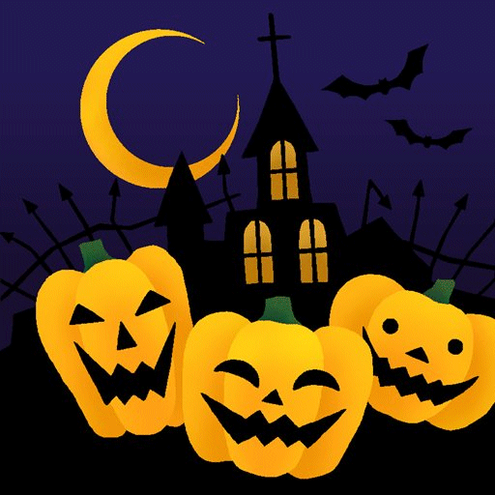
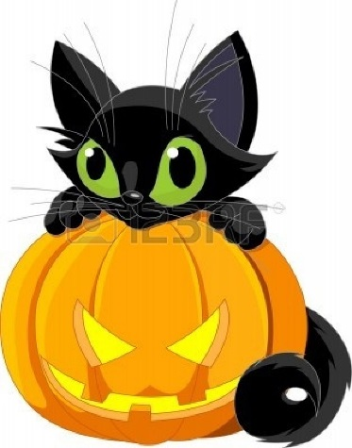
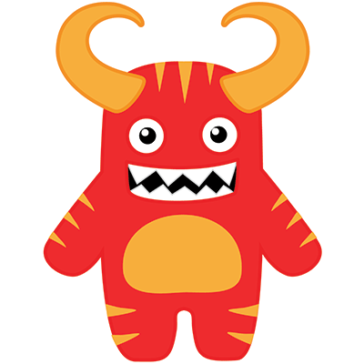
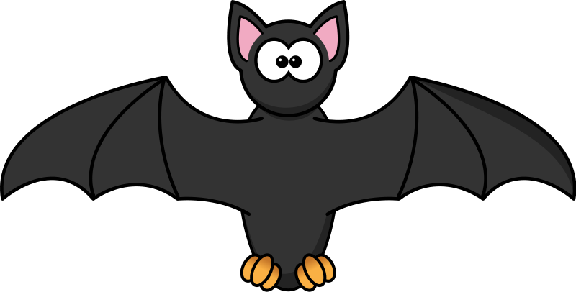
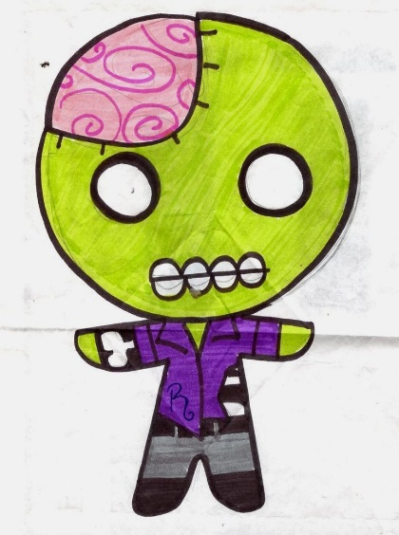
Lea offers Emily to go trick-or-treating with her. Emily walks with her sister on the street. On the street Lea sees a lot of different disguises like : a black cat, a monster, a zombie and a bat. Lea shows her sister the black cat one. She likes it a lot.
I want that costume for next year.

Slide 6
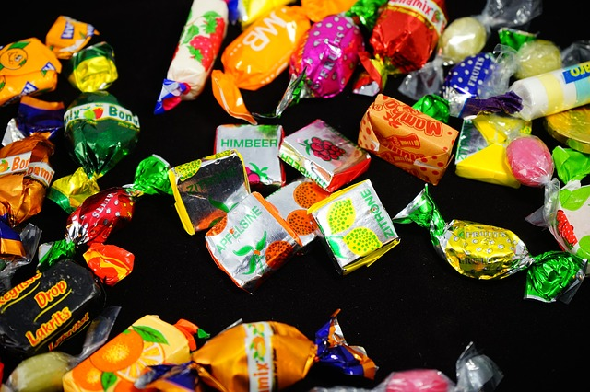
Emily knocks at a door when a spooky Frankenstein appears and he gives her some candies.
Happy Halloween!
Emily you have more candies than me.
Don’t worry! I’m going to share some with you.

Slide 7
The End!

