Slide 1
The Frightening Right Street.
By Catherine and Nelly
Intensive English
October 31

Slide 2
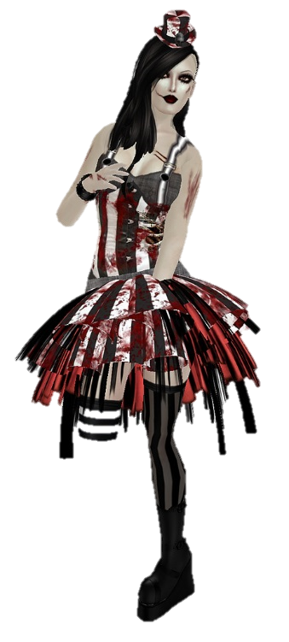
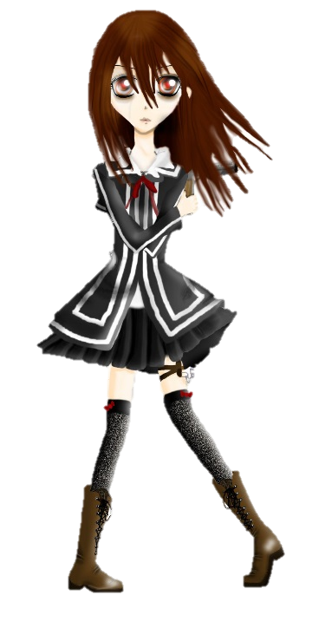
It’s October 31 and all the students are in class. Gaby is impatient to go trick or treating but Alice is scared to go. When the bell rings Gaby runs to the school’s door. Alice walks very slowly. A little bit later the two girls are at the door.
Boo!
HA! What do you do?!?
Can I pass
Halloween with you?
Yes OK.

Slide 3
Gaby wants to go to the right of the street because it’s more scary. Alice thinks is going to be more fun if they go to the left. Gaby persuades Alice to go right.
I am really afraid. I want to go left.
Don’t worry. I will protect you.
left
right

Slide 4
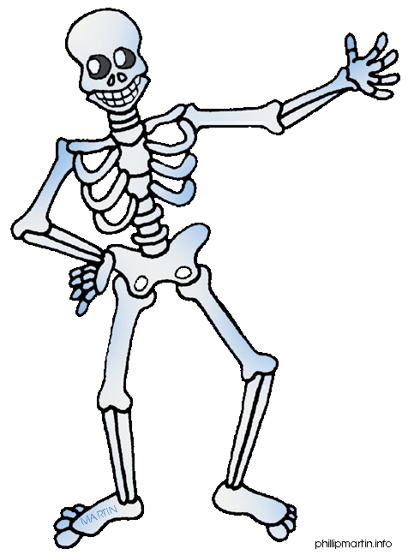
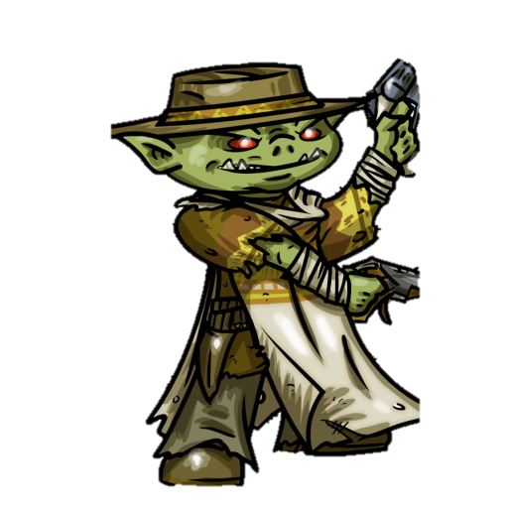
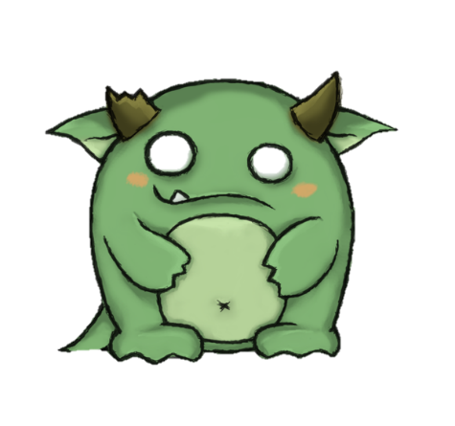
On their way , Gaby and Alice see terrifying things. Gaby finds an ugly goblin,a skeleton, an old ghost and a spirit. Alice observes a spooky monster , a devil , a black bat and an owl.
HAA!

Slide 5
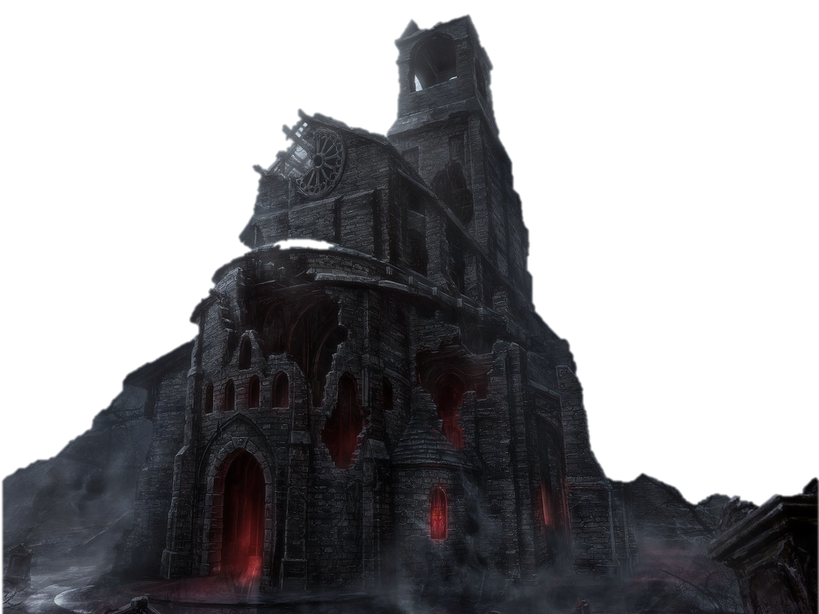
Gaby goes in a haunted house. Alice dosen’t want to stay alone so she follows her.
This is a horrifying place!

Slide 6
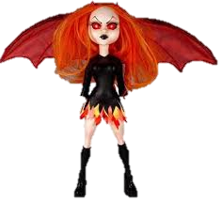
Gaby discovers a freaky clown. A dead doll touches Alice. At the end of the haunted house they are in a cemetary.
Ha! Look at this freaky clown.
Ha! a dead doll touches me.

Slide 7
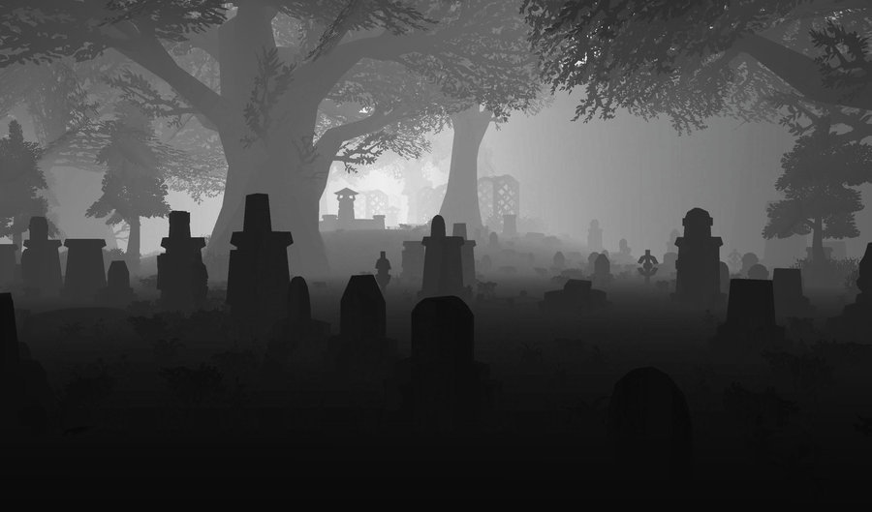
In the cemetery, Alice stumbles on a tombstone and falls on bones. Gaby comes to help her.
Ouch!
Are you O.K.?
No, I scrached my knees.

Slide 8
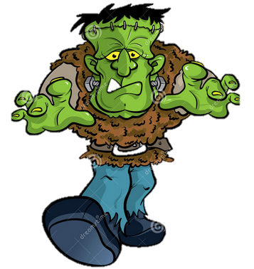
She helps her to walk on the street. Suddenly, Frankenstein appears in front of the two girls and makes them scream.
BOO!
Get out of our way!
I have an injured person with me.
HA!
I am sorry.

Slide 9
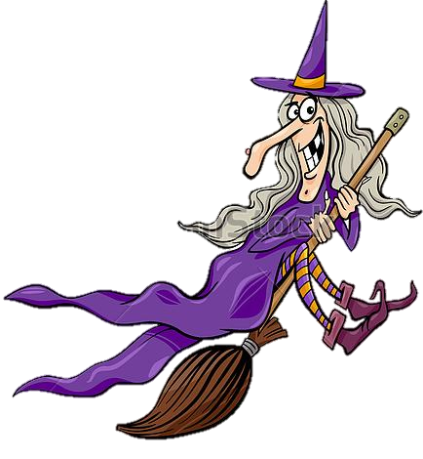
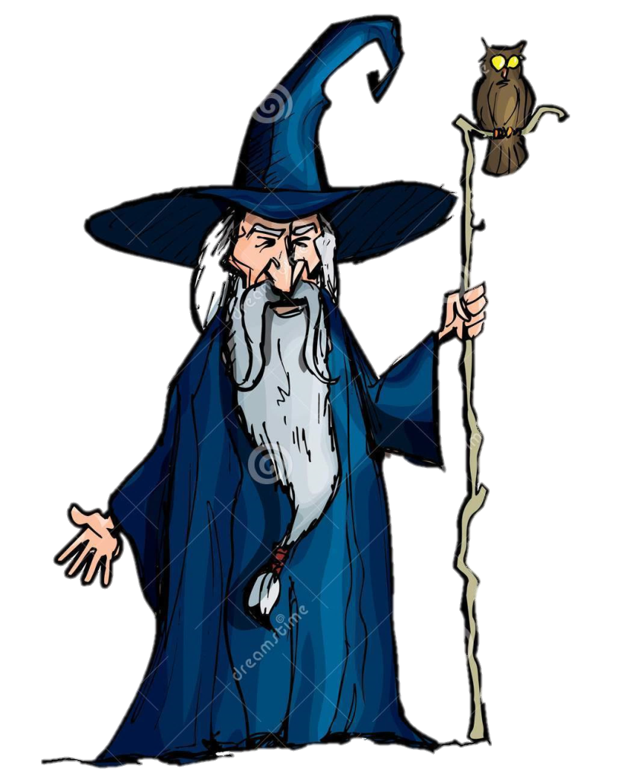
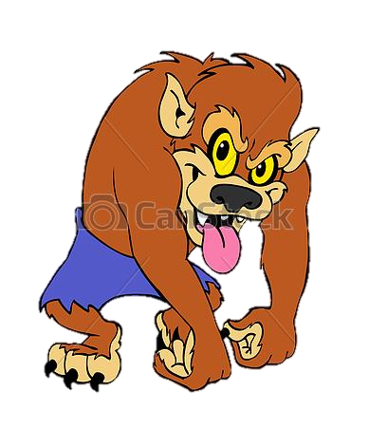
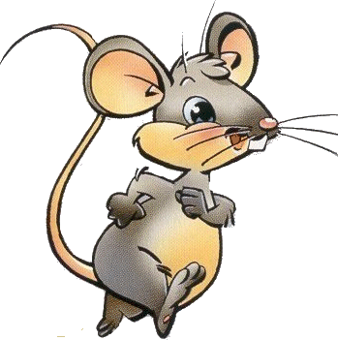
Frankenstein calls his friends: the witch, the werewolf, the wizard and the mouse.
We are here to help you!

Slide 10
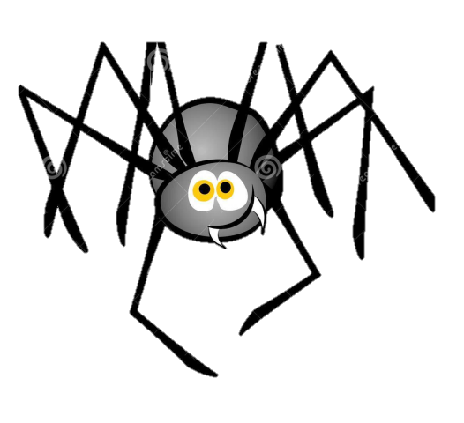
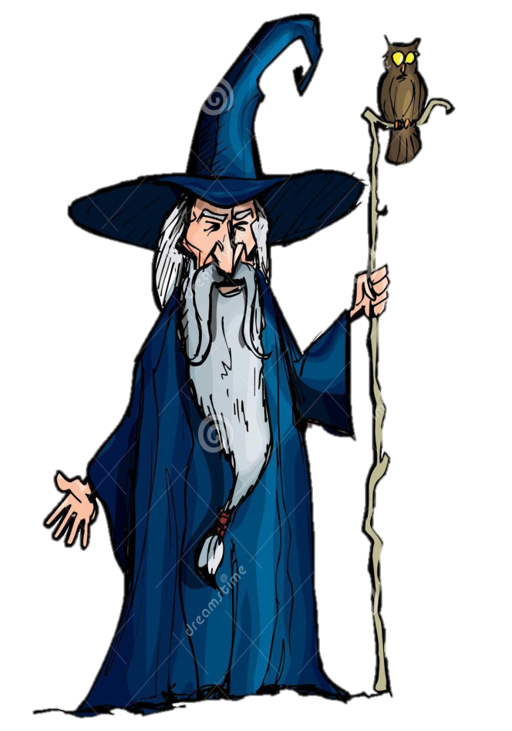
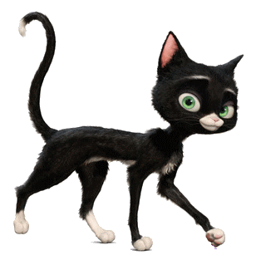
In the darkness, they bring Alice home. On their way they see a black cat, a skull, some spiders and a pumkin.
This skull is
terrifying !
I am affraid of
spiders.
I don’t like pumkin.
I hate cats!

Slide 11
Twenty minutes later, they are at Alice’s home. They are safe and sound. The monsters and the two girls share their candies.
Thank you very much.
You’re welcome!

Slide 12
THE END

