Slide 1
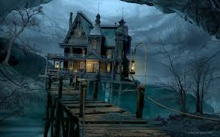
The Haunted House
By: Anne-Peniel and Shayana
INTENSIVE ENGLISH
October,31 st ,2015

Slide 2
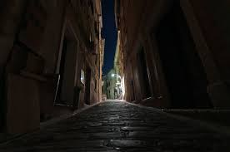
It’s a scary ,black and dark Halloween night of October 31st. Elisa a young girl wants to go in the Haunted House . she is too Afraid to go in it alone . She walks down the street to find Amber, her bestfriend.
Llallalalala .Candies candies give me some candies .
Mysterious creature go away . Scary wizard Lallaallallalallalalalal .

Slide 3
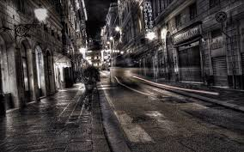
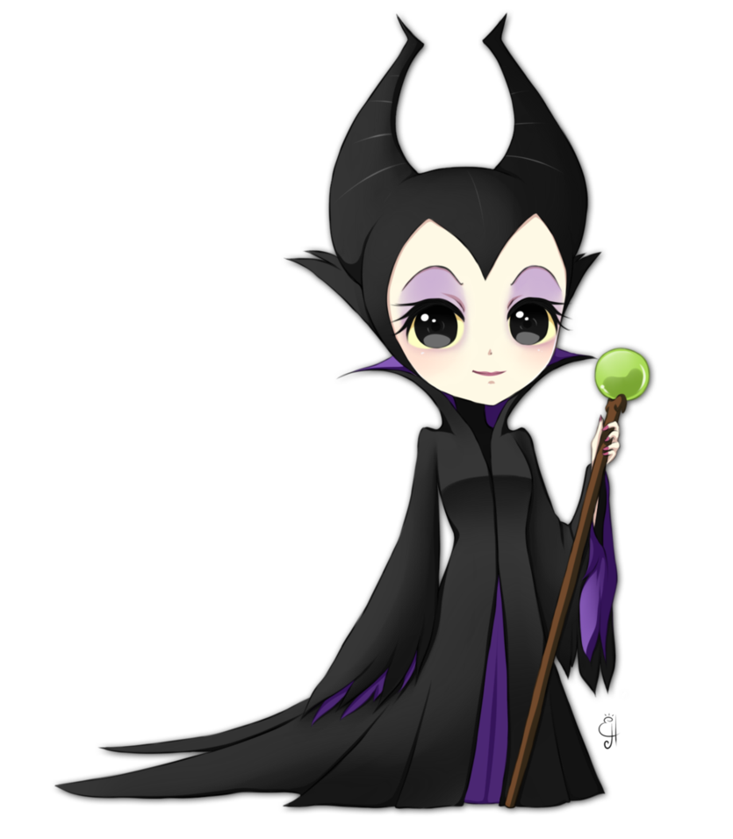
She finally finds her after a long moment . She is dressed like an evil fairy. She asks the question that she has in her head .
Finally ! You are here all this time.
Hey ! Elisa I like your angel costume .
Thanks ! Please, come with me to the Haunted House .
Ok, I will go with you because they give us candies when we find the exit .

Slide 4
So now , the two girls arrive in front of the door. They wait a little bit in line.They enter and the wind (wooo) closes the door . ( Boum!)
Too bad ! This is such a cool place.
Ah ! Please let me go .

Slide 5
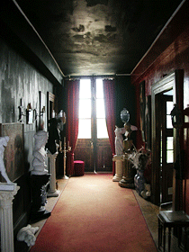
They walk in the house . Elisa realises that they are lost . The white-haired little girl hears the floor creaking ( creak creak creak) . A ghost comes out of nowhere .(woohh)
Stop screaming ! You are breaking my ears.
Oh my god ! I don’t want to die today.

Slide 6
She continues to walk. A witch comes from nowhere while making sound (ee ee ee ). She tells them she makes a potion with toenails. Amber decides to go in one direction and Elisa goes in another.

Slide 7
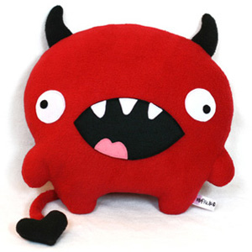
Elisa sees a monster (raaaah). It says «grrr» quietly .
Grrr .
Mommy !

Slide 8
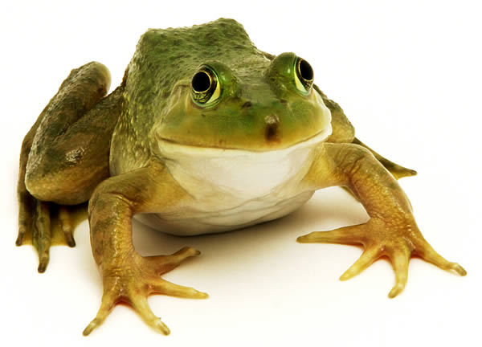
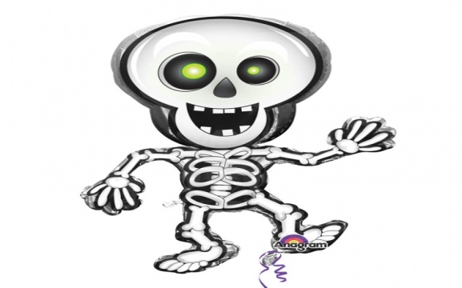
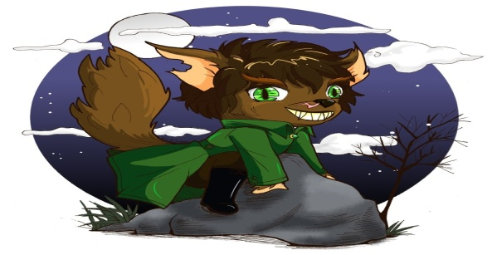
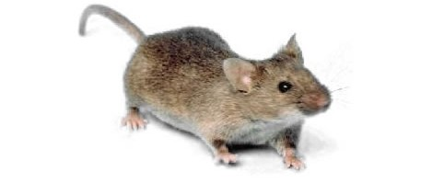
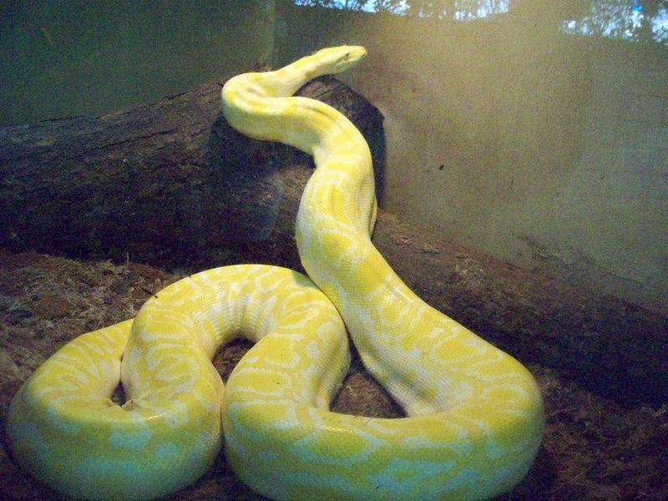
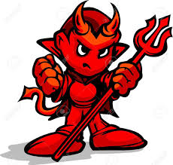
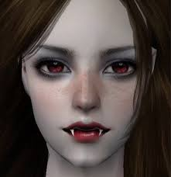
She recognizes that it is not terrifying. It looks very inoffensive. The monster declares that it brings her out of the house. During the journey she notices a skeleton , a bat , a mouse , a vampire , a frog , a devil , a snake ,a werwolf and finally the way out. She thanks him .
Thank you so much .
You’re welcome !

Slide 9
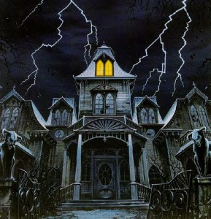
She eventally locates Amber .She is waiting beside the door . At the end, they receive candies . They go to their home.At the same time they hear a wolf howling .(Haoooo )

